Slide 1
Capstone Design
Team 13
20165729
20161344
20161090
Park Sangwoo
Heo JeongWoo
Lee Chaemin

Slide 2
Contents
1.
Feedback
New Project
schedule
Q&A
2.
3.
4.

Slide 3
1.
Q&A Feedback

Slide 4
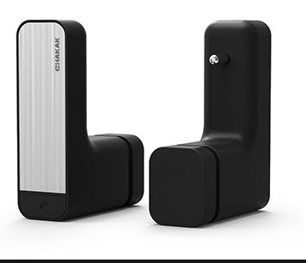
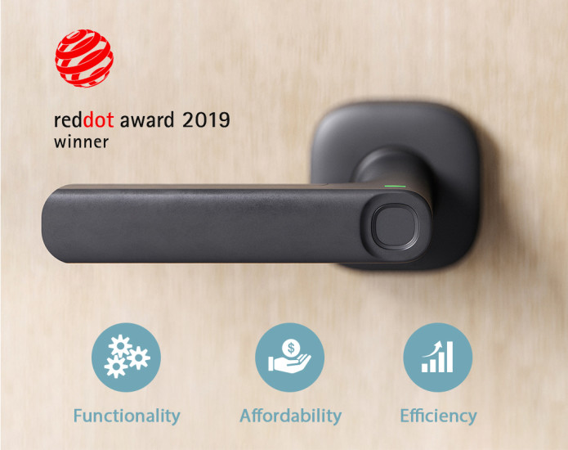
1
Q&A Feedback
Similar device
Similar concept device
CHAKAK(차칵)
FIDO

Slide 5
2.
New Project

Slide 6
2
New Project
Title
3D room reconstruction using smartphone
We want to help you choose house by providing the exact room size in 3D

Slide 7
2
New Project
Motivation
Uncomfortable with the existing way of finding a room
It is very difficult to look around real estate without any information &
It’s hard to find a good house

Slide 8
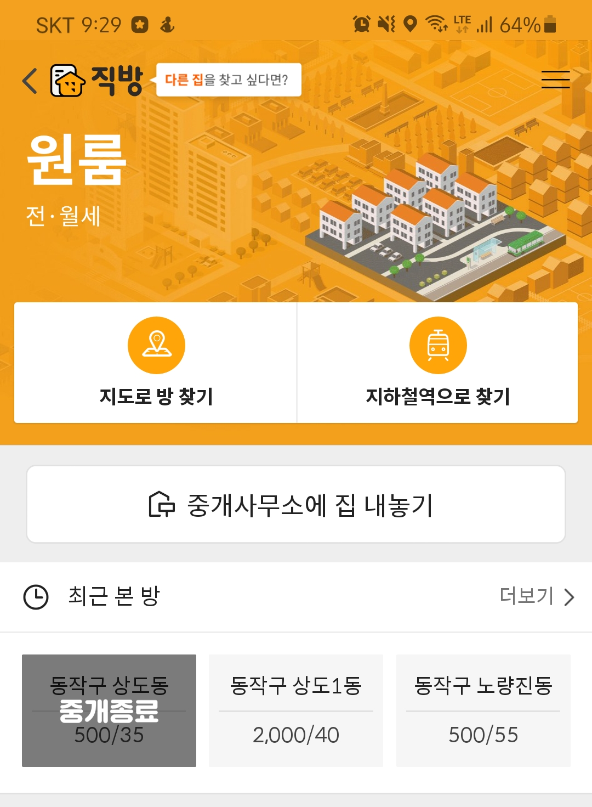
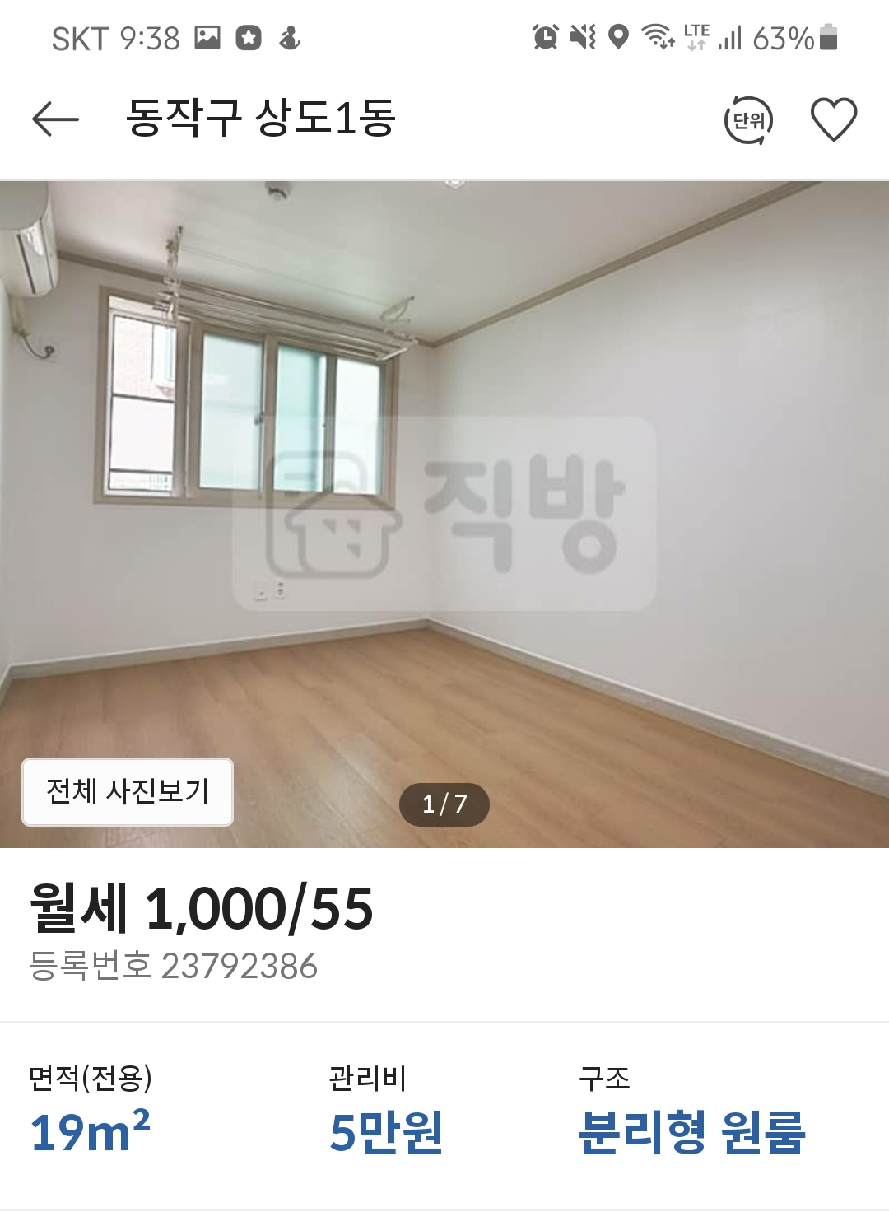
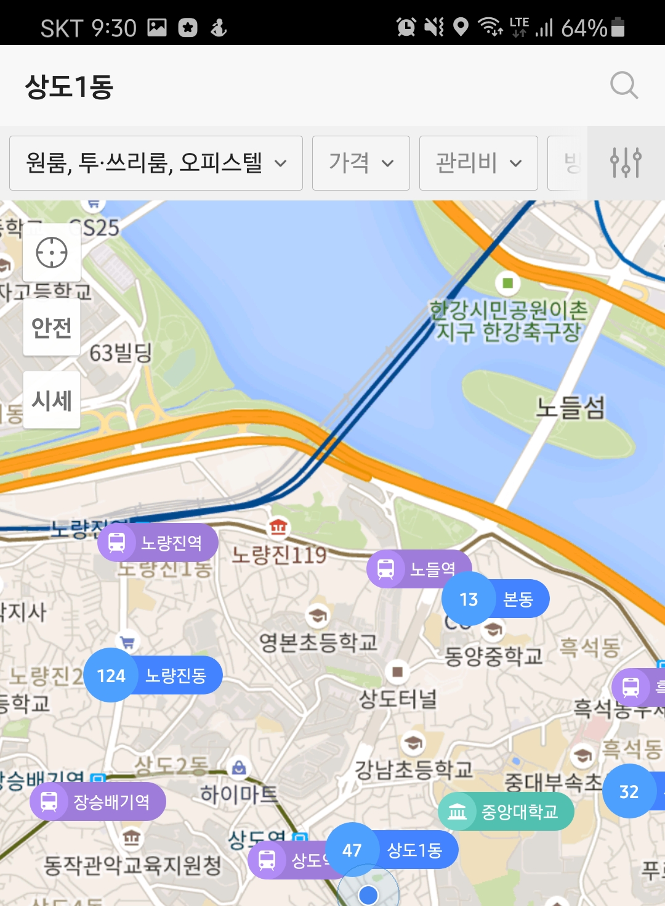
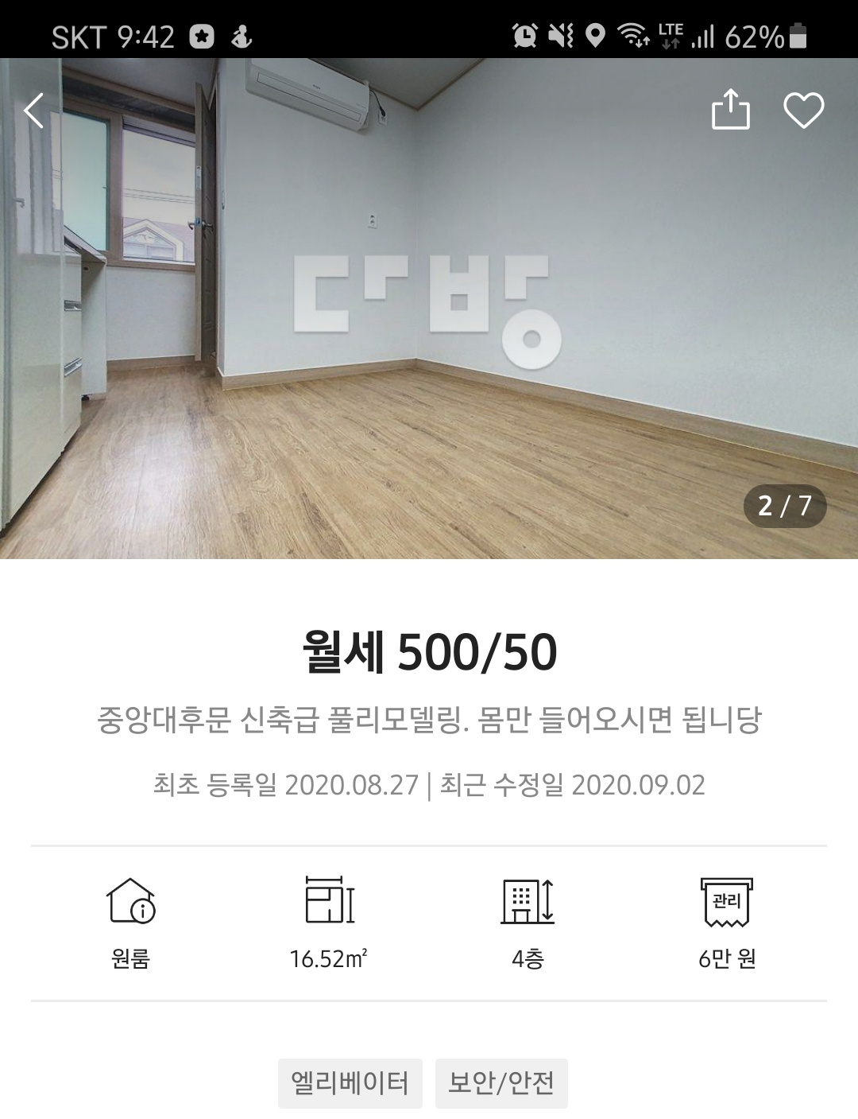
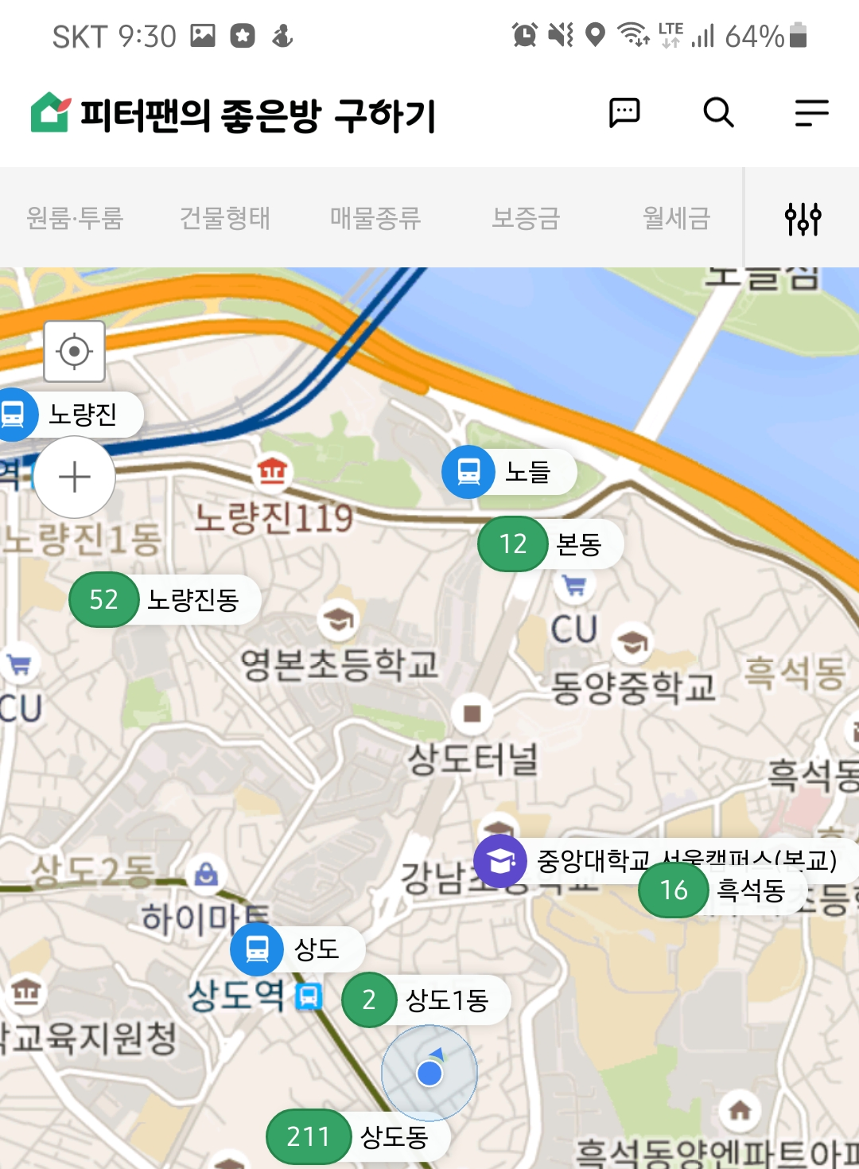
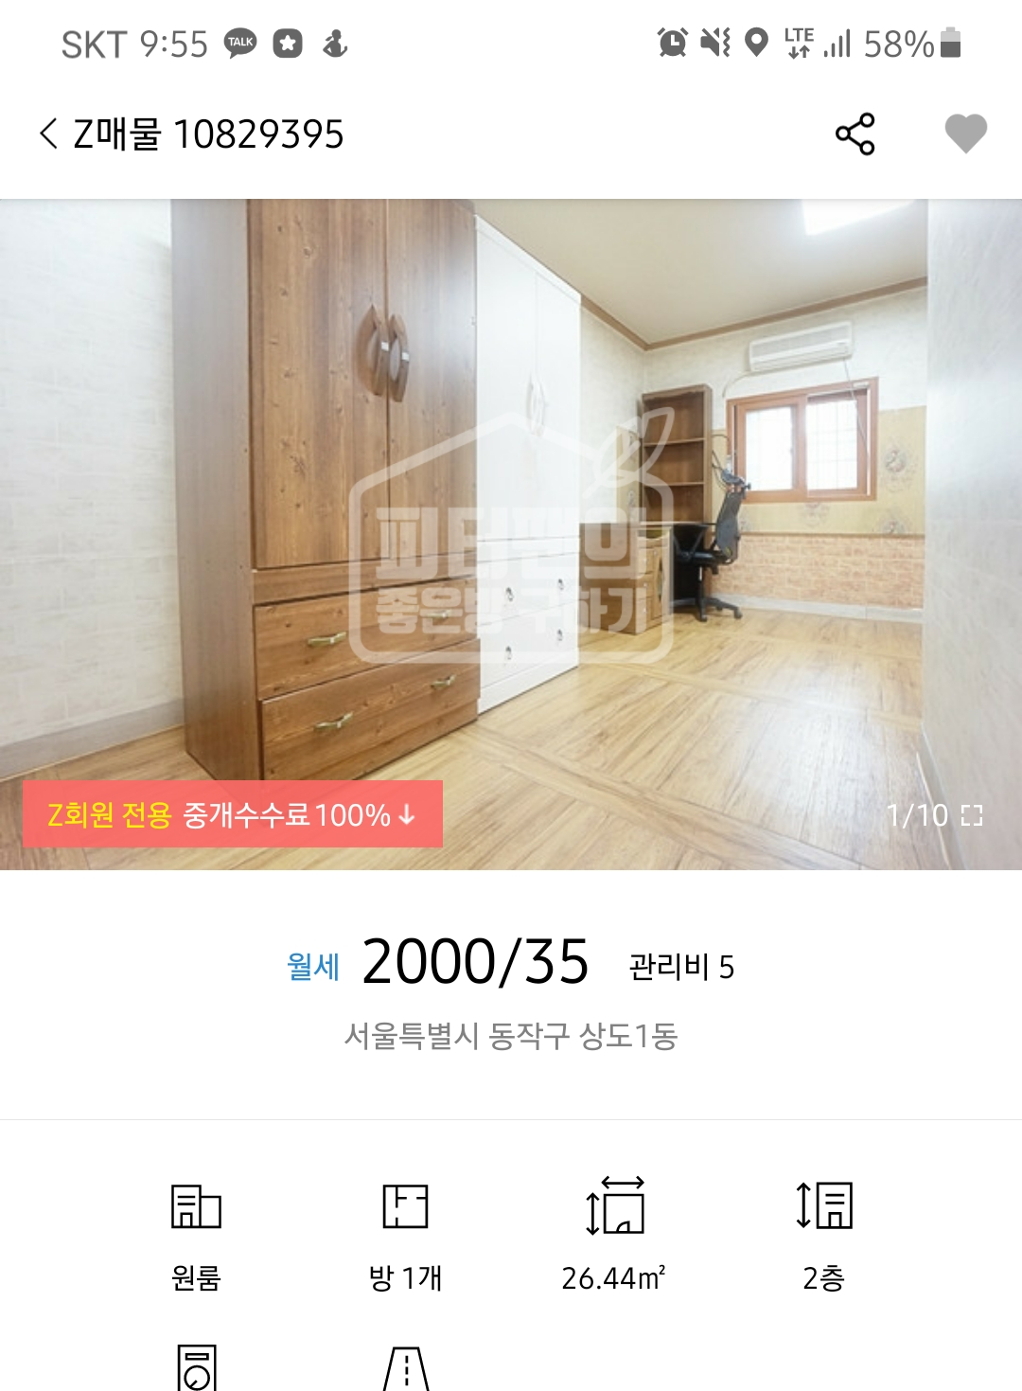
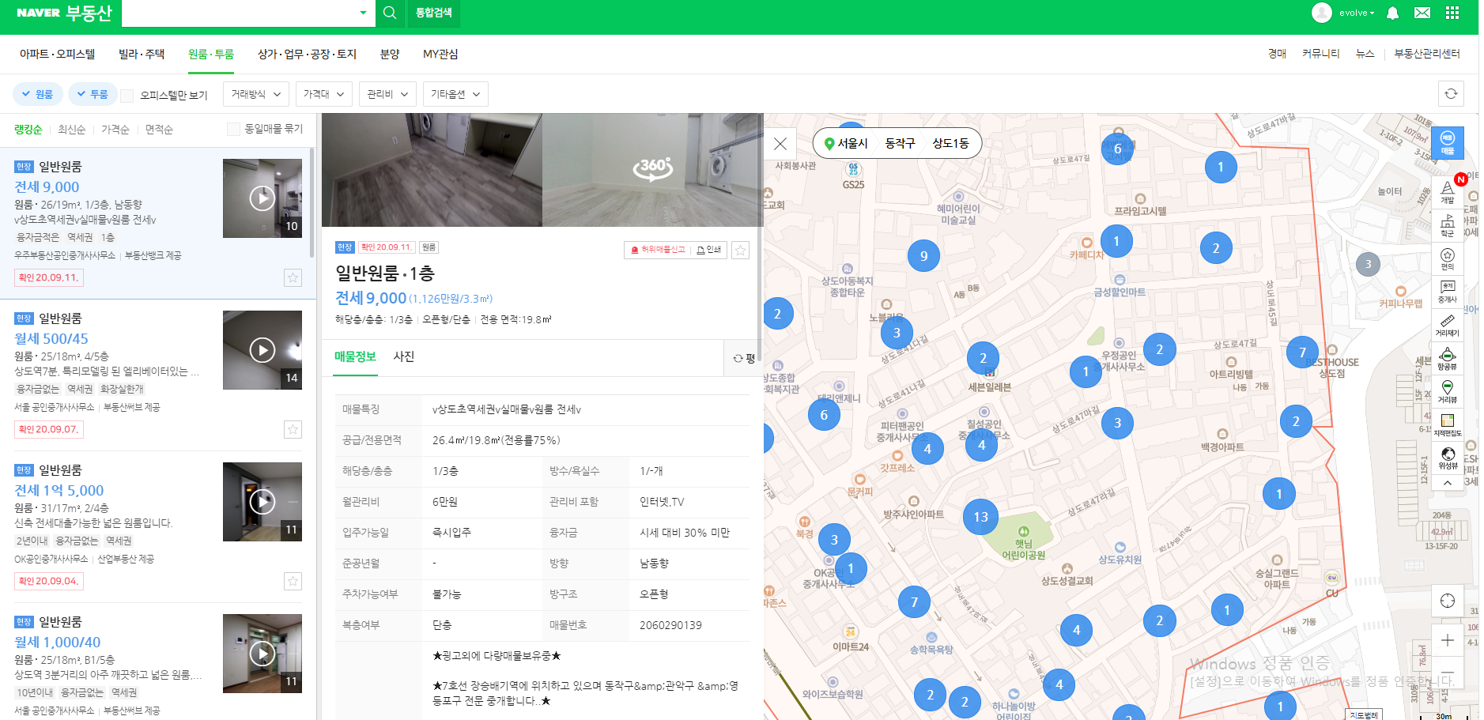
2
Model
How to get information

Slide 9
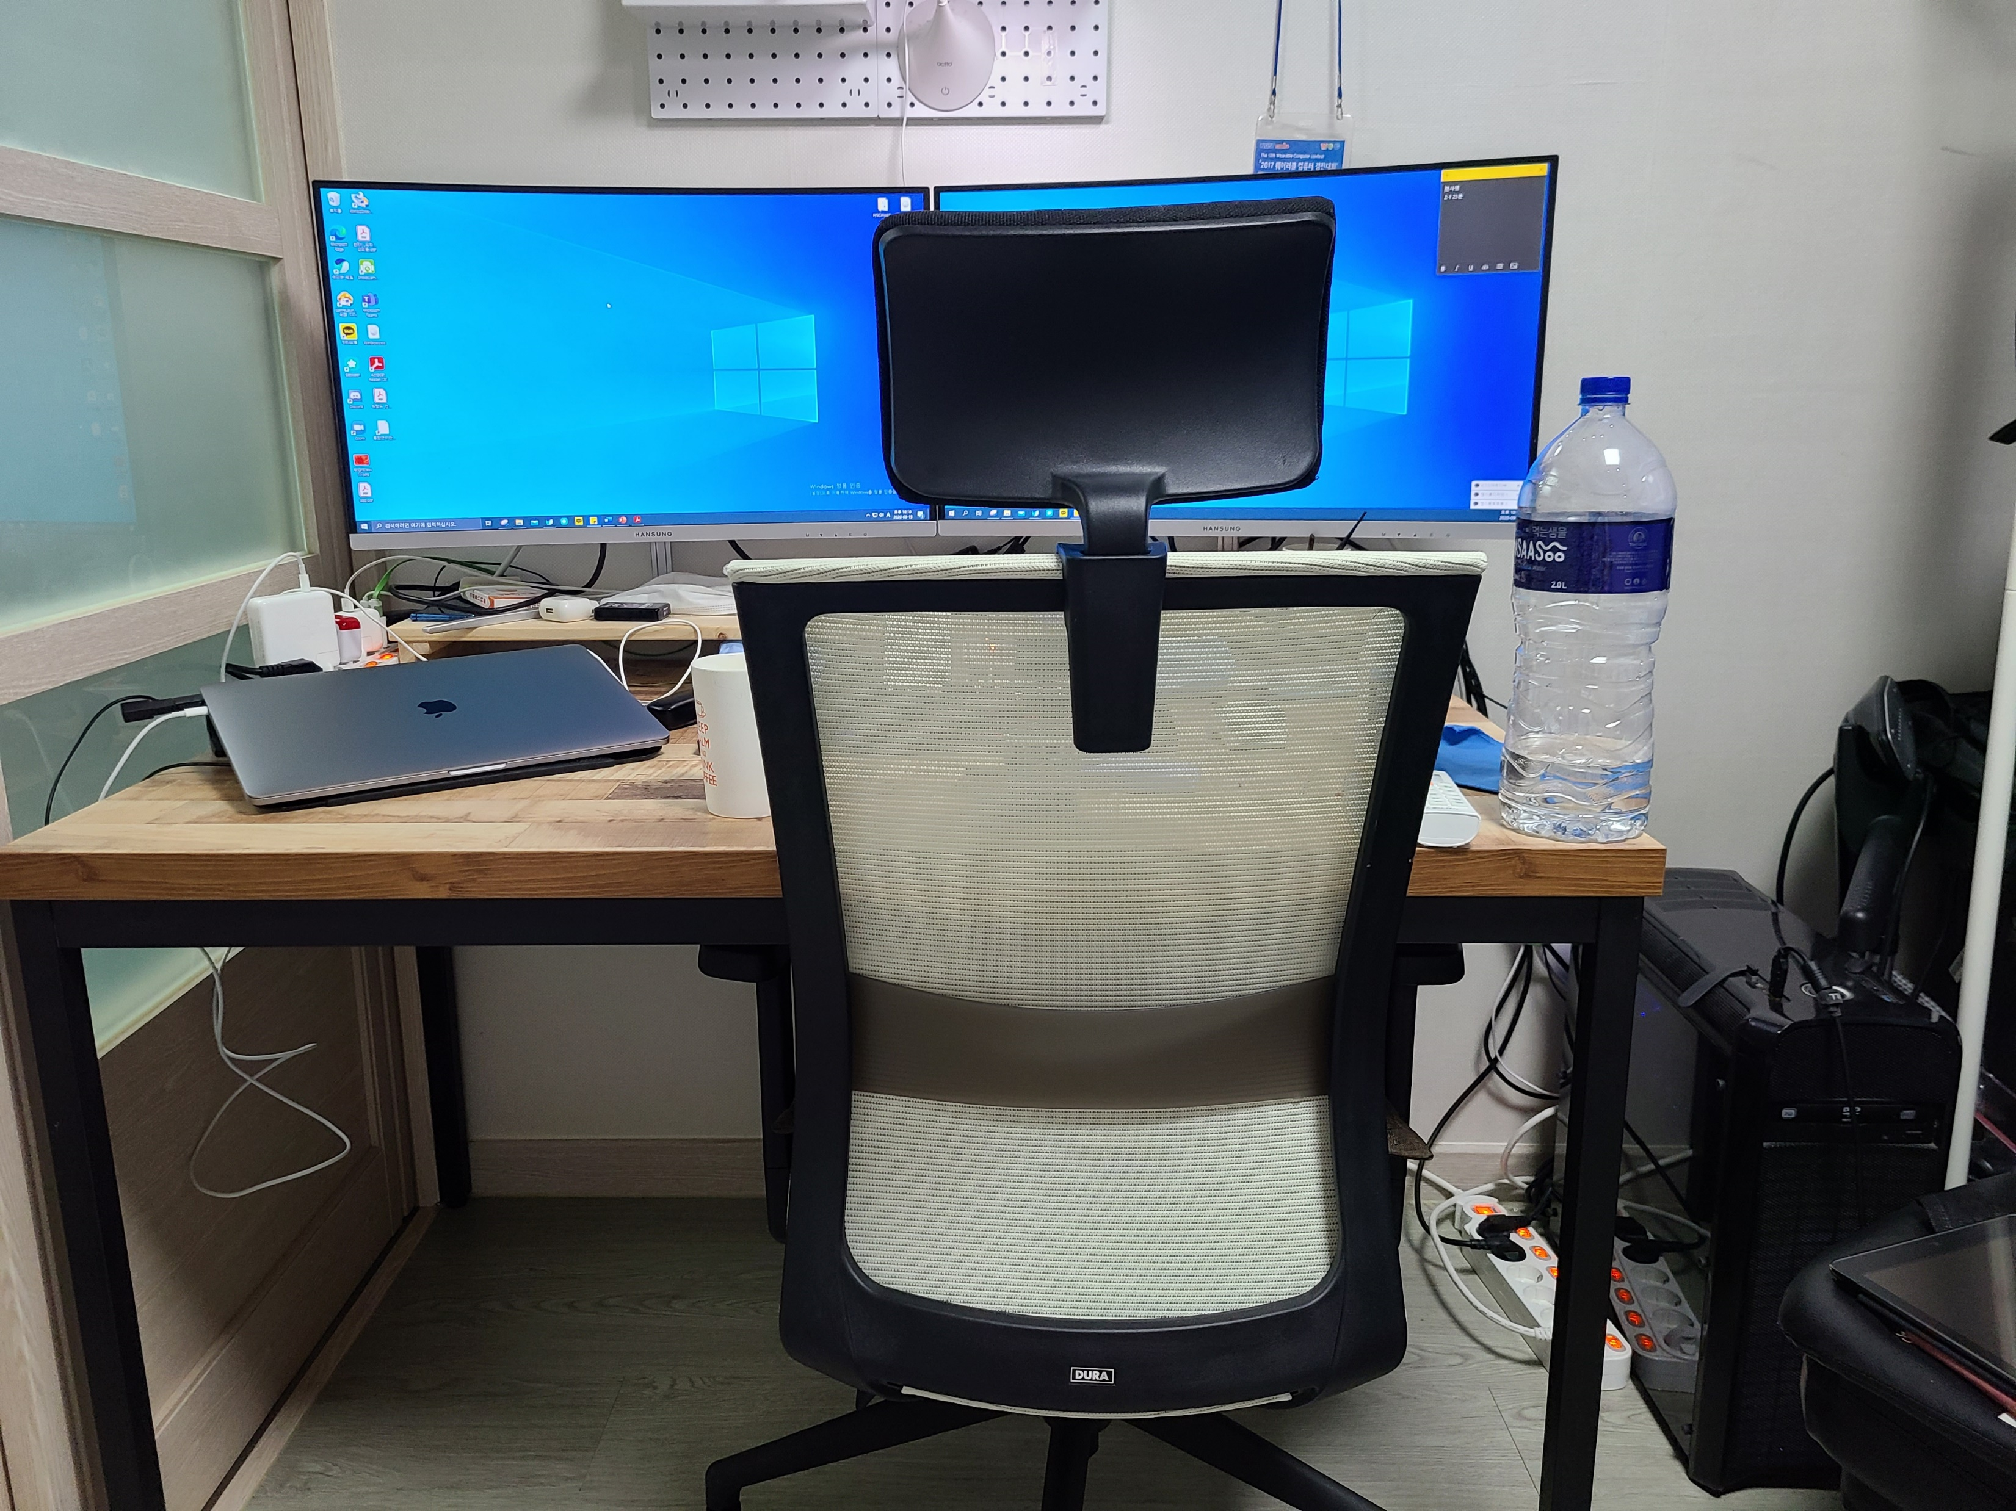
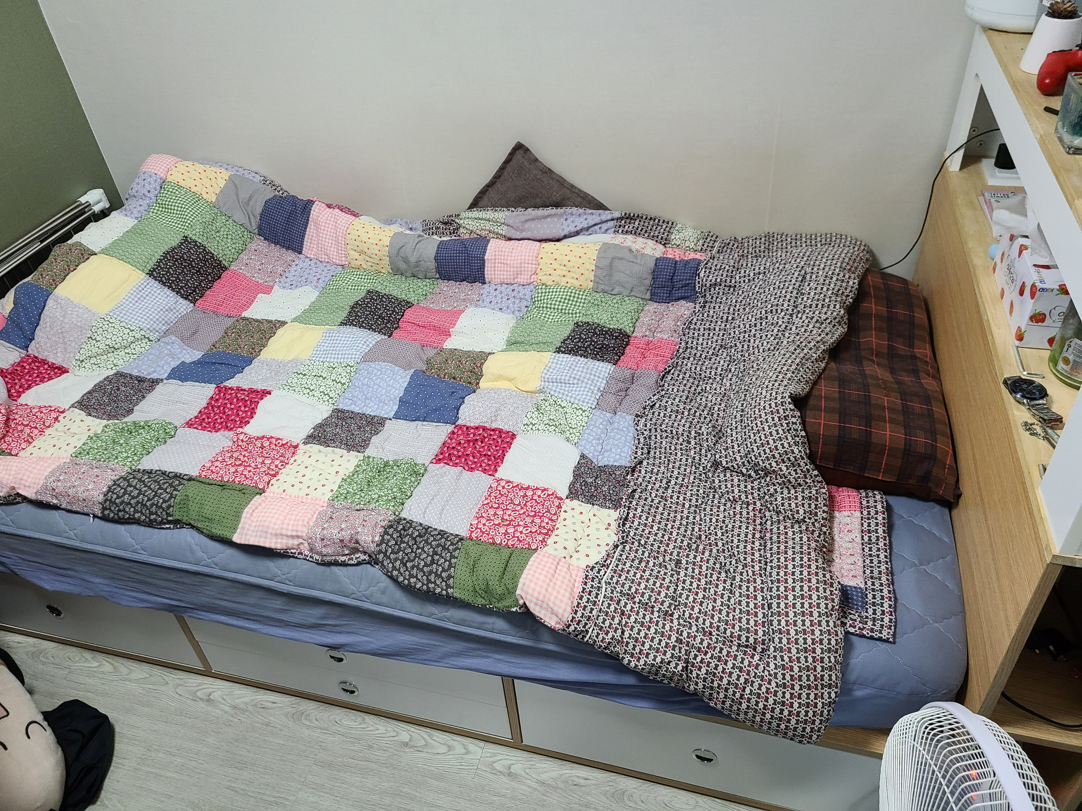
2
New Project
Question
Only photos…
My furniture can fit in?
Is it the size I want?

Slide 10
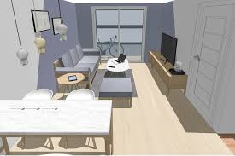
2
New Project
3D
Already, many people use 3D modeling for interior
But, we need to prepare a floor plan
&
We need to know how to model 3D

Slide 11
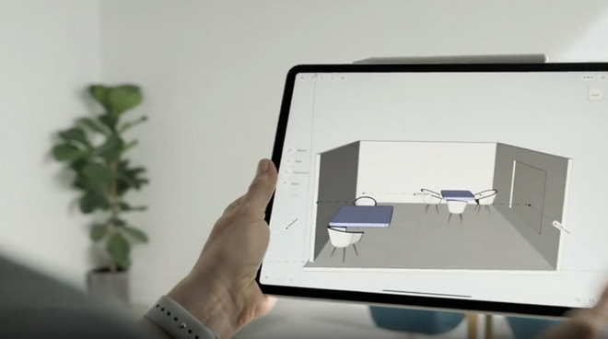
2
New Project
3D
Similar concept application
But this application is difficult to normal user.

Slide 12
2
New Project
Goal
3D room reconstruction using smartphone
Scanning room use smartphone
Furniture arrangement
Share my room model for sale through application

Slide 13
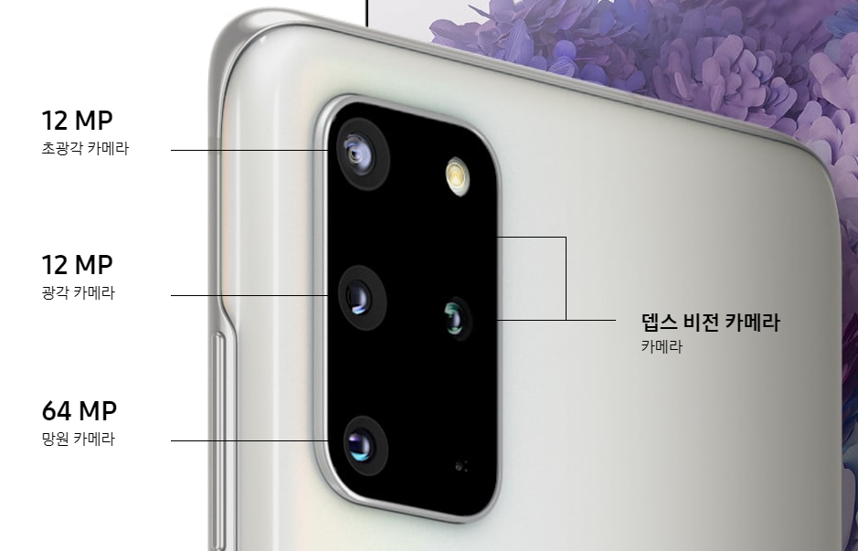


2
New Project
How to?

Slide 14
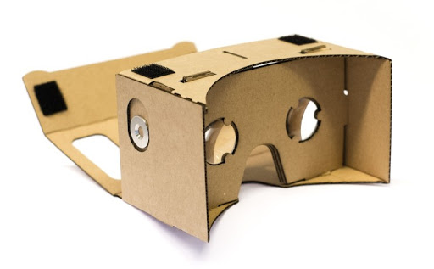
2
New Project
Optional

Slide 15
3.
Schedule

Slide 16
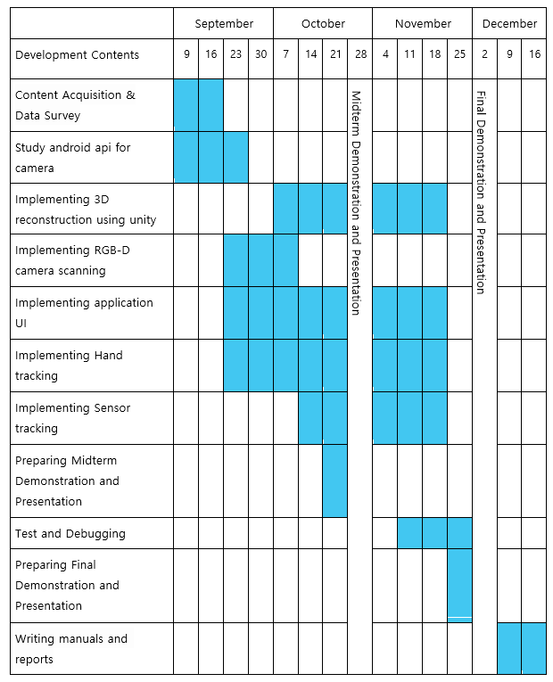
3
Total Schedule

Slide 17
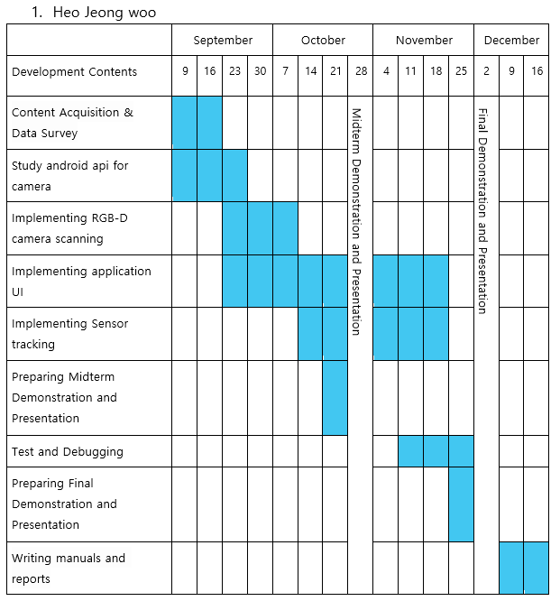
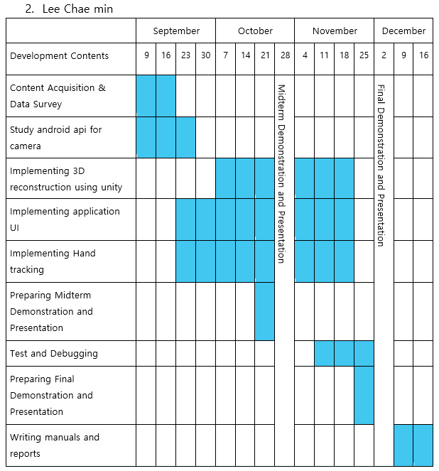

3
Schedule

Slide 18
4.
Q&A

